Slide 1
#PowerPlatform
- Yash Agarwal
#GlobalPowerPlatformBootcamp
#GPPBHYD

Slide 2

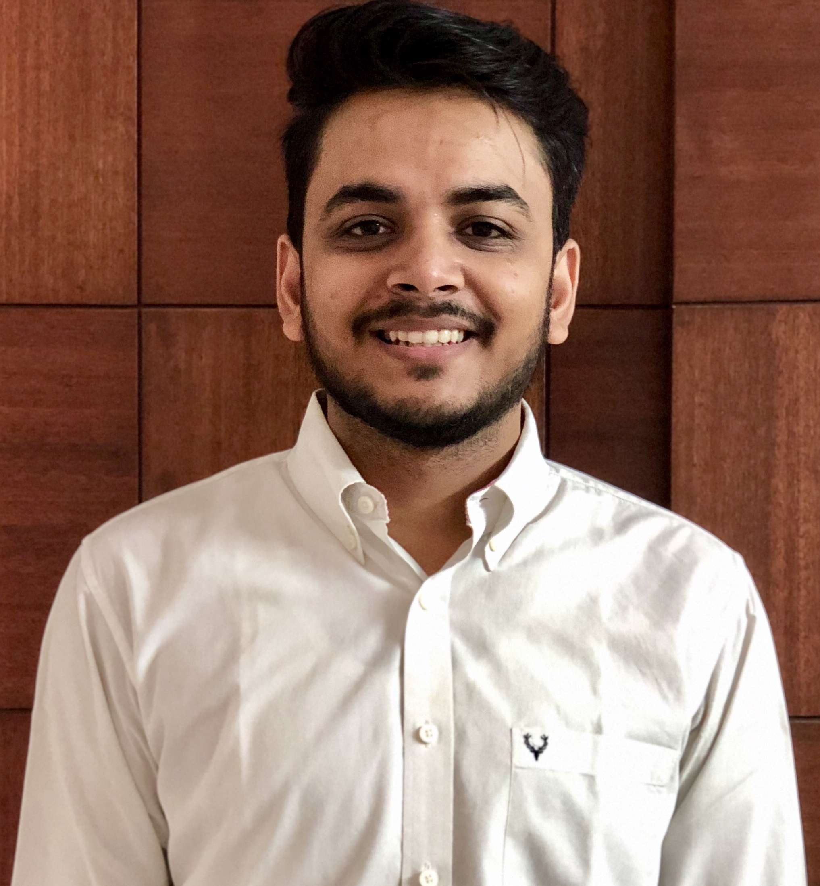




Software Developer, Applied Info Services. Microsoft Business Applications MVP. Flownaut (Power Automate Community SuperUser) Appstronaut (Power Apps Community SuperUser) yashagarwal1651 @gmail.com
Yash Agarwal
@yashagarwal1651
https://bythedevs.com

Slide 3
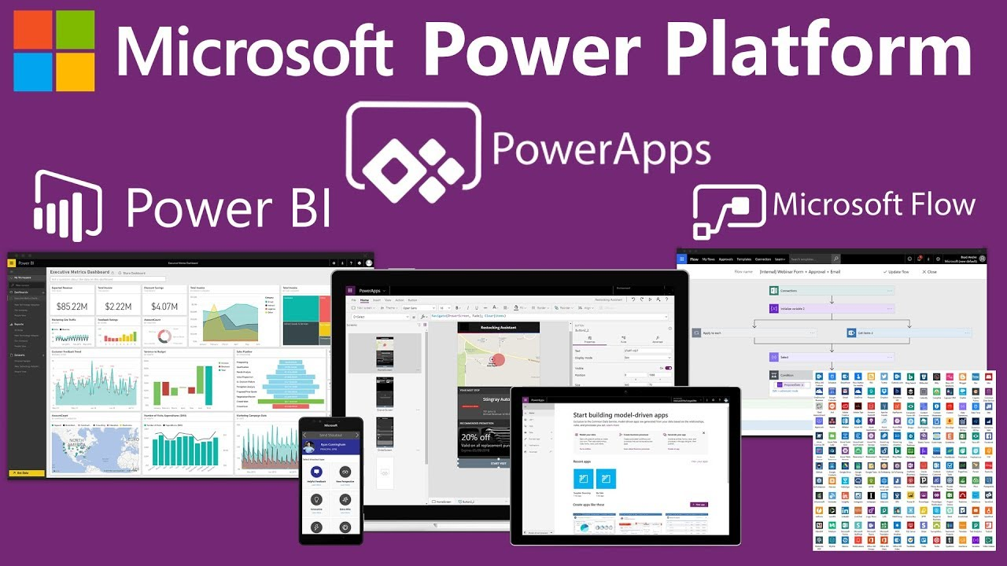
#PowerPlatform
Image source: https://i.ytimg.com/vi/_ptOnH-z1uY/maxresdefault.jpg

Slide 4
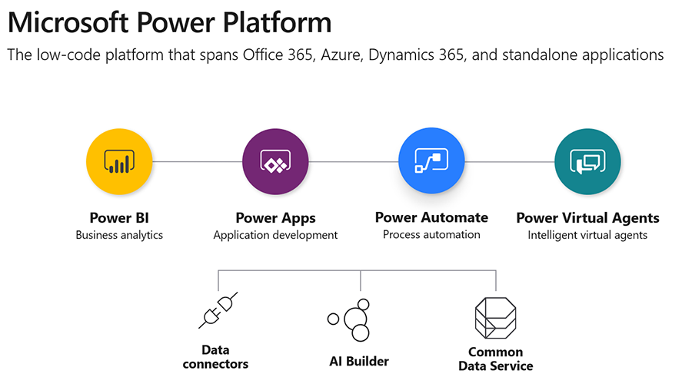
Building a Customer Service Tool

Slide 5
Demo

Slide 6
Any Questions?

Slide 7
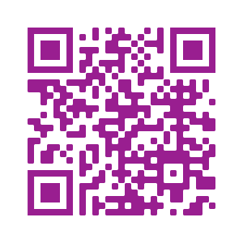
Please fill out the survey! & Win Swags!!
https://www.powerplatformbootcamp.com/survey

Slide 8
Thank You For Attending

